Slide 1
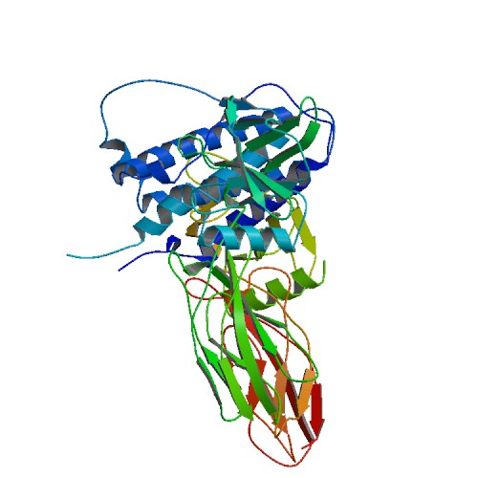
Darbepoetin alfa
Drugbank ID : DB000012

Slide 2
Description :
Aranesp (darbepoetin alfa) is an erythropoiesis-stimulating protein that is produced in Chinese hamster ovary (CHO) cells by recombinant DNA technology. Aranesp is a 165-amino acid protein that differs from recombinant human erythropoietin in containing 5 N-linked oligosaccharide chains, whereas recombinant human erythropoietin contains 3 chains. The 2 additional N-glycosylation sites result from amino acid substitutions in the erythropoietin peptide backbone. The approximate molecular weight of darbepoetin alfa is 37,000 daltons.
Indication :
For the treatment of anemia (from renal transplants or certain HIV treatment)
Pharmacodynamics :
Darbepoetin alfa is used in the treatment of anemia. It is involved in the regulation of erythrocyte differentiation and the maintenance of a physiological level of circulating erythrocyte mass.

Slide 3
Mechanism of action :
Darbepoetin alfa stimulates erythropoiesis by the same mechanism as endogenous erythropoietin. Erythropoietin interacts with progenitor stem cells to increase red cell production. Binding of erythropoietin to the erythropoietin receptor leads to receptor dimerization, which facilitates activation of JAK-STAT signaling pathways within the cytosol. Activated STAT (signal transducers and activators of transcription) proteins are then translocated to the nucleus where they serve as transcription factors which regulate the activation of specific genes involved in cell division or differentiation.
.

Slide 4
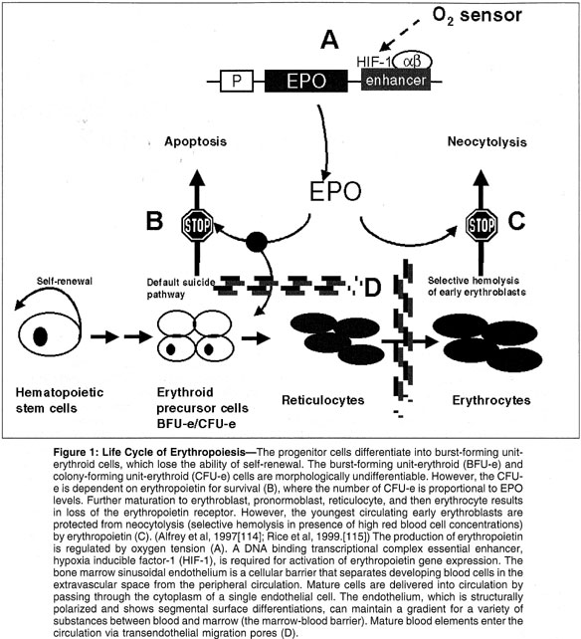

Slide 5
Targets :
Erythropoietin receptor
Affected organisms :
Humans and other mammals

Slide 6
Categories :
Hematinics and Anti-anemic Agents
Patents :
number country approved expired
2165694 Canada 2003-03-18 2010-10-15
2147124 Canada 2002-11-05 2014-08-16
Sequence :
APPRLICDSRVLERYLLEAKEAENITTGCAEHCSLNENITVPDTKVNFYAWKRMEVGQQAVEVWQGLALLSEAVLRGQALLVNSSQPWEPLQLHVDKAVSGLRSLTTLLRALGAQKEAISPPDAASAAPLRTITADTFRKLFRVYSNFLRGKLKLYTGEACRTGDR

Slide 7
Brands : Aranesp
Company : Amgen Inc
Description : Aranesp (darbepoetin alfa) is an erythropoiesis-stimulating protein that is produced in Chinese hamster ovary (CHO) cells by recombinant DNA technology. Aranesp is a 165-amino acid protein that differs from recombinant human erythropoietin in containing 5 N-linked oligosaccharide chains, whereas recombinant human erythropoietin contains 3 chains. The 2 additional N-glycosylation sites result from amino acid substitutions in the erythropoietin peptide backbone. The approximate molecular weight of darbepoetin alfa is 37,000 daltons.
Used for/Prescribed for : Aranesp is used to treat anemia (a lack of red blood cells in the body).
Formulation : Each 1 mL contains polysorbate 80 (0.05 mg), sodium chloride (8.18 mg), sodium phosphate dibasic anhydrous (0.66 mg), and sodium phosphate monobasic monohydrate (2.12 mg) in Water for Injection, USP (pH 6.2 ± 0.2).
Form : sterile, colorless, preservative-free solution containing polysorbate
Route of administration : intravenous or subcutaneous administration

Slide 8
Contraindication : allergic, untreated or uncontrolled high blood pressure or have ever had pure red cell aplasia caused by using darbepoetin alfa or epoetin alfa. Side effects : serious side effects such as: fever, chills, body aches, flu symptoms; feeling like you might pass out; easy bruising, unusual bleeding (nose, mouth, vagina, or rectum), purple or red pinpoint spots under your skin; seizure (black-out or convulsions); or dangerously high blood pressure (severe headache, blurred vision, buzzing in your ears, anxiety, confusion, chest pain, shortness of breath, uneven heartbeats, seizure). And Less serious Aranesp side effects may include: stomach pain; mild cough; mild skin rash or redness; or pain, bruising, swelling, warmth, redness, oozing, or bleeding where the IV needle is placed Drug interaction : A total of 25 drugs (63 brand and generic names) are known to interact with Aranesp (darbepoetin alfa) among which 3 major drug interactions (6 brand and generic names), 1 moderate drug interactions (4 brand and generic names) and 21 minor drug interactions (53 brand and generic names). MAJOR INTERACTIONS ARE; lenalidomide pomalidomide, Pomalyst (pomalidomide)

Slide 9
References : http://www.aranesp.com/ http://www.rxlist.com/aranesp-drug.htm http://www.drugs.com/aranesp.html

